Slide 1
Task Management
By Gaurav Walia

Slide 2
Problem Statement
On Front End:
Implement a feature to add Tasks.
Implement a feature to set the due date for these tasks.
On Back end:
Implement the backend in one of the desired Tech-Stacks provided below.
Your backend is supposed to store all the tasks data received from the Frontend and store it in the Database.
You are also supposed to implement a Database in the Backend which should store all this structured data.
The data sharing between Frontend and Backend should be in JSON format rendered over REST APIs.
Zip all your Source Code, Screenshots, Deployment Instructions and Upload.
Plus Point (intermediate)
Implement a feature to set Labels to Tasks like ‘Personal’, ‘Work’, ‘Shopping’ and ‘Others’.
Implement a feature to set the Status of the Tasks like ‘New’, ‘In progress’ and ‘Completed’.
You are supposed to implement these features for an End-to-End stack, implementation will go on the Frontend as well as Backend.
Store the relevant flags in the database.
Extra Work (experienced / wizard)
Implement the Signup and Login/Logout functionality. You have to create user-auth schema in the database.

Slide 3
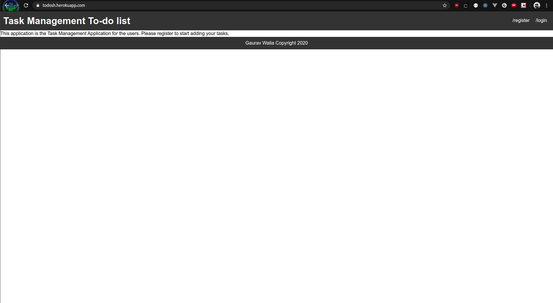
Default Page when you open the application

Slide 4
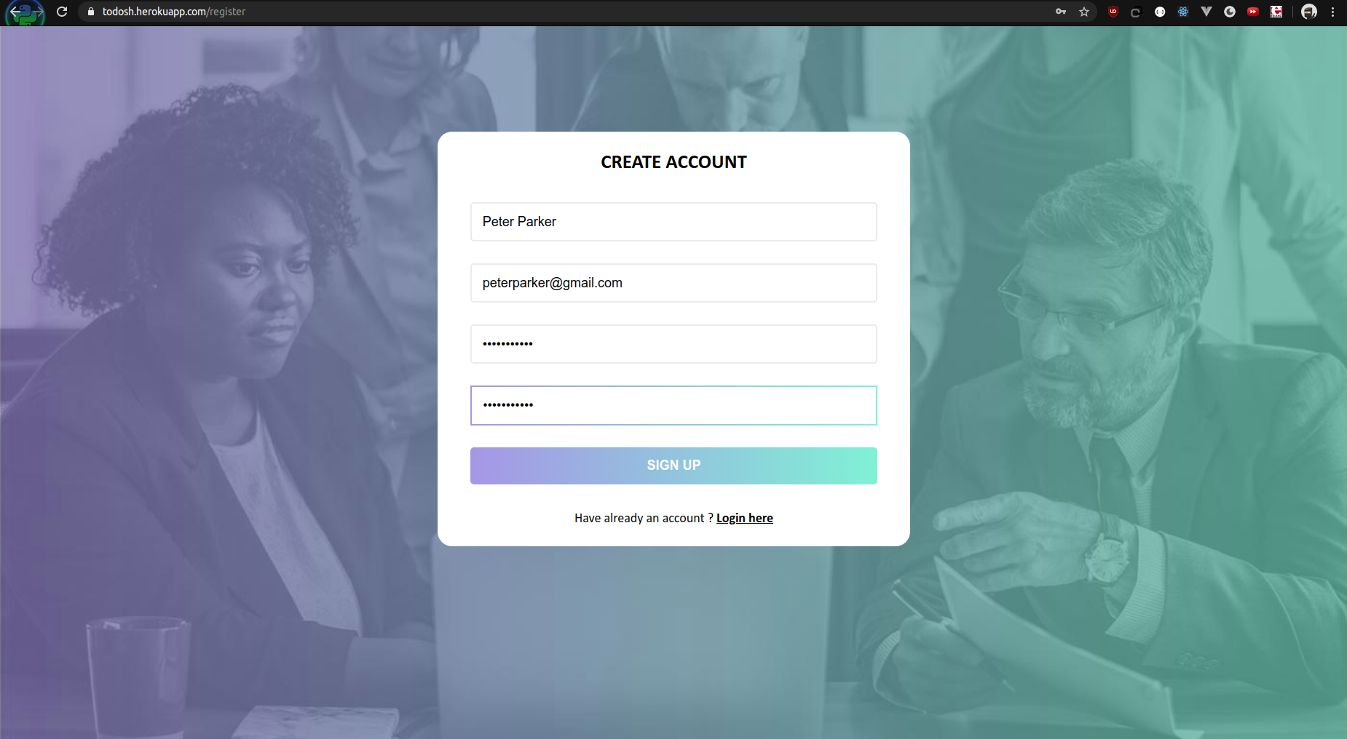
Register a new user

Slide 5
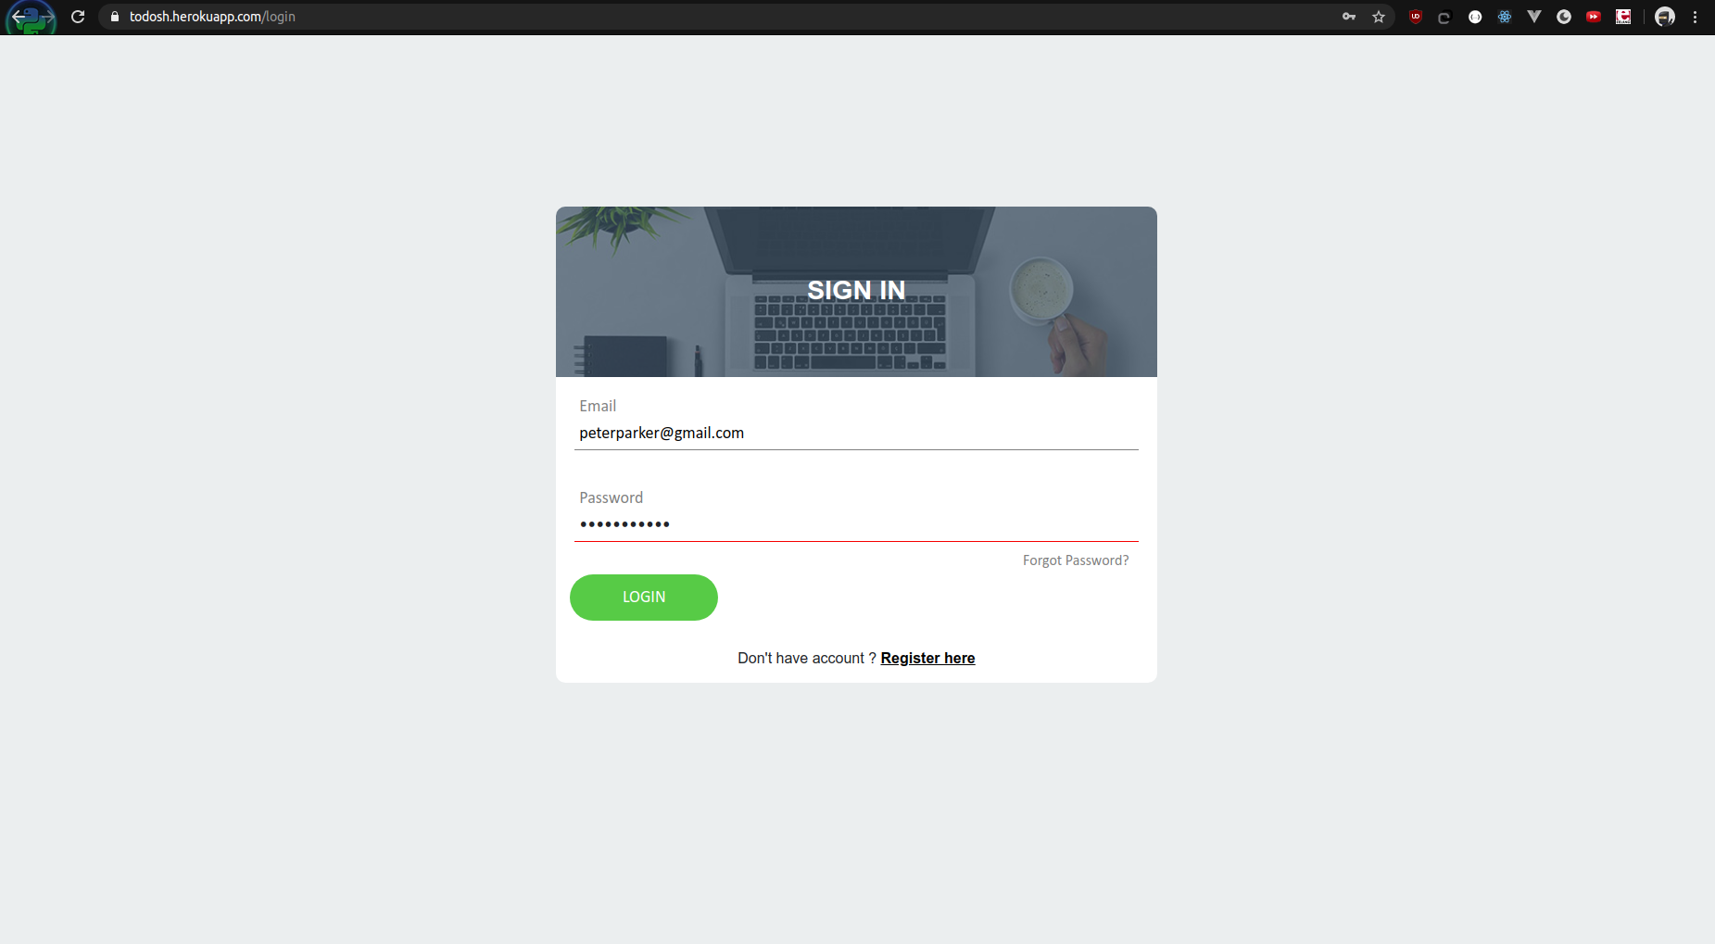
Login with the user

Slide 6
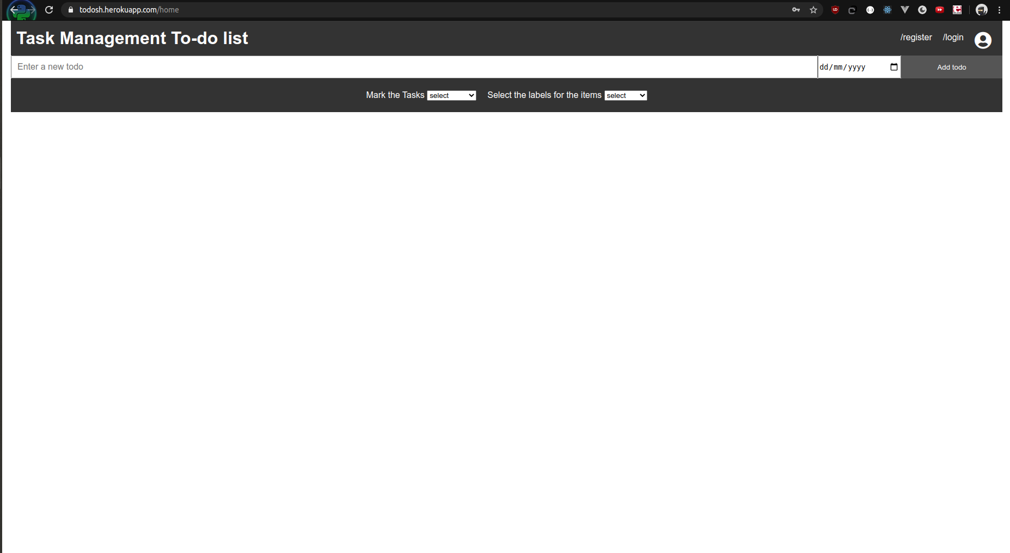
Todo App to add new todos

Slide 7
Adding Todos
Add todo by adding the text in new todo input and click on add todo to add a new one
Todo Due Date support by default it will take today's date it not mentioned
By default no labels will be attached with new todo
By default new todo is mentioned with red color calendar icon to show it is a new task.
You can go to register and login page easily with the header nav links
You can remove the todos also.

Slide 8
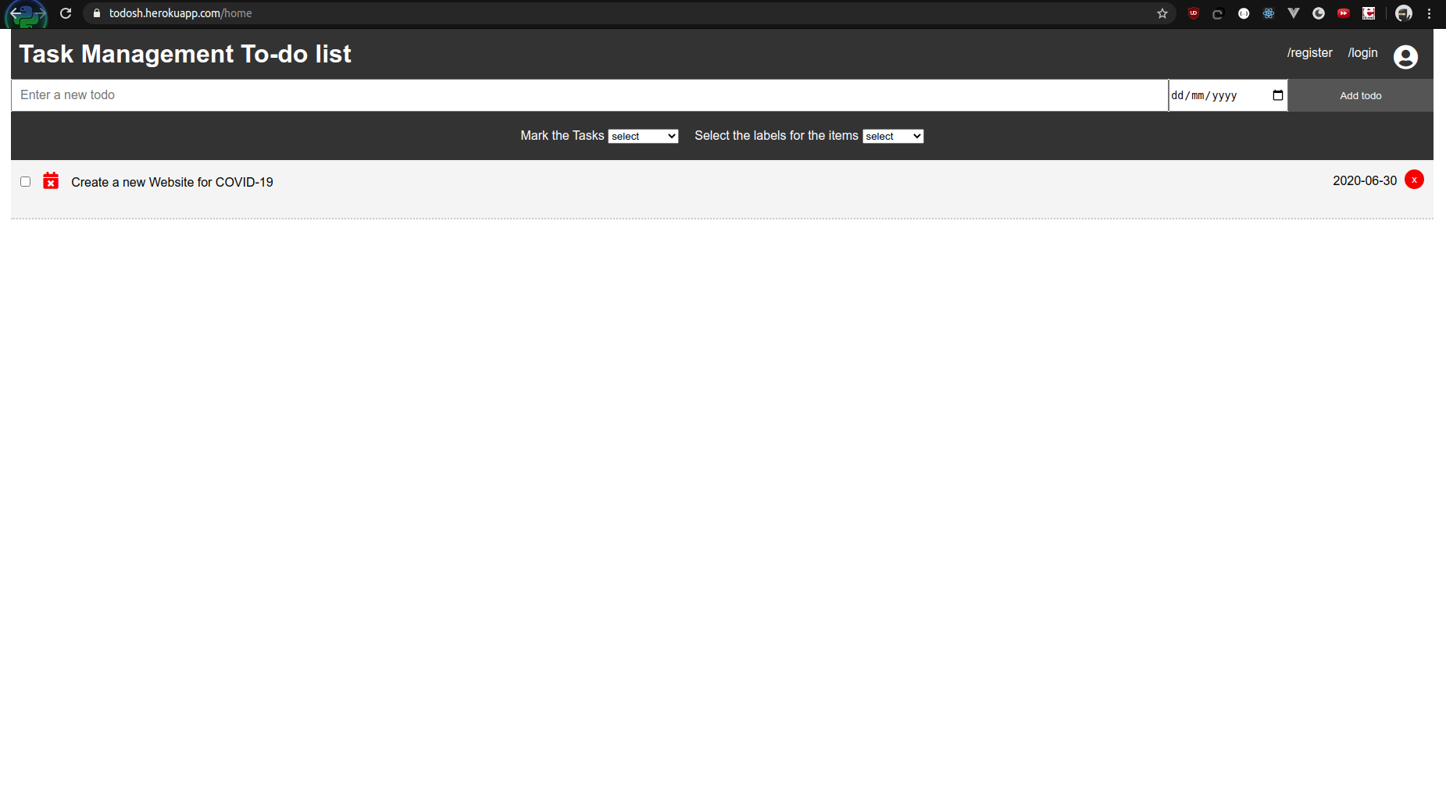
Sample Todo

Slide 9
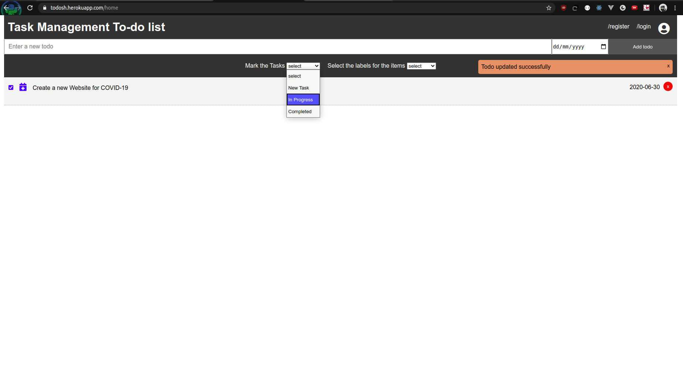
Mark the todos as New, In Progress and Completed

Slide 10
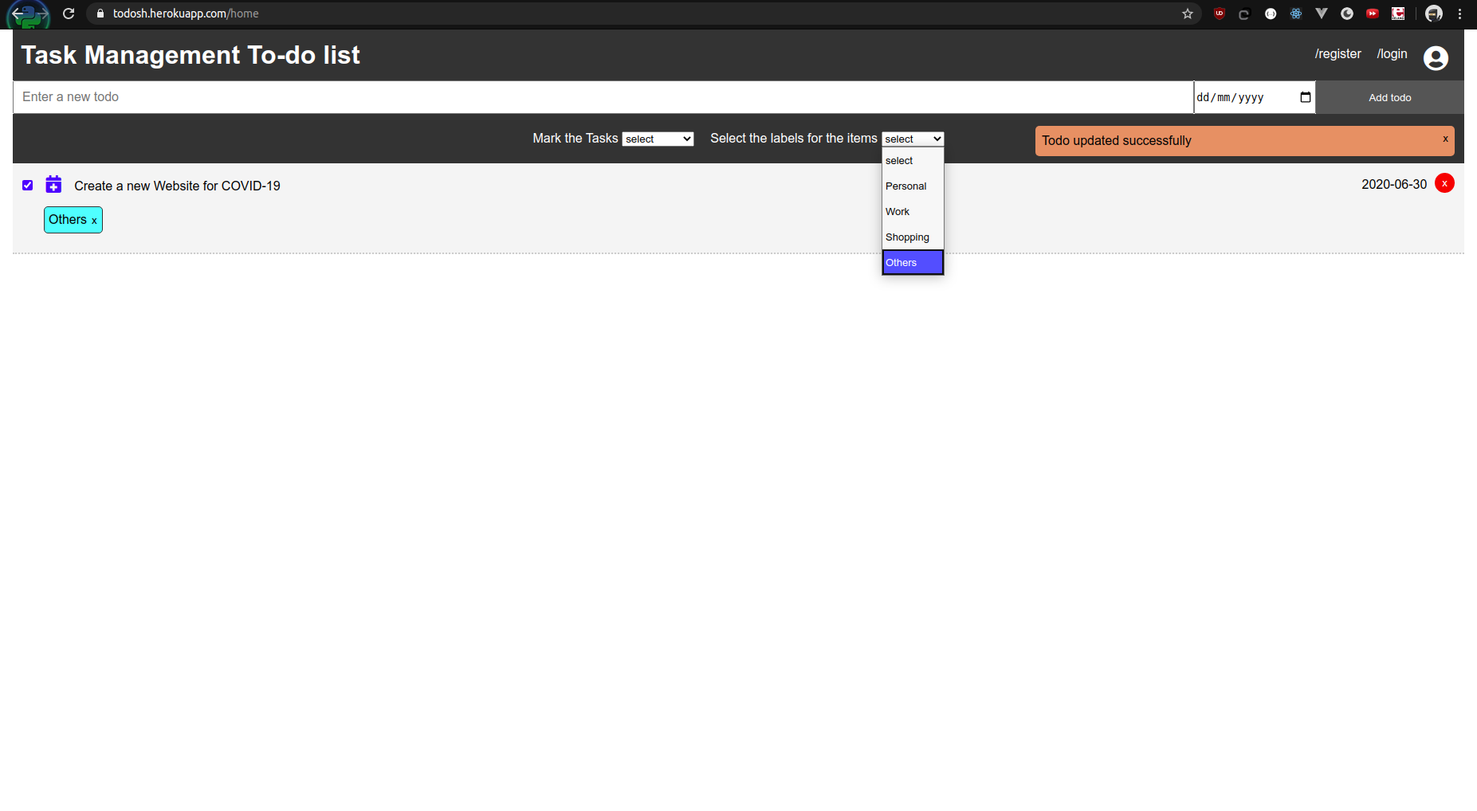
Add new labels to the todos
Personal
Work
Shopping
Others

Slide 11
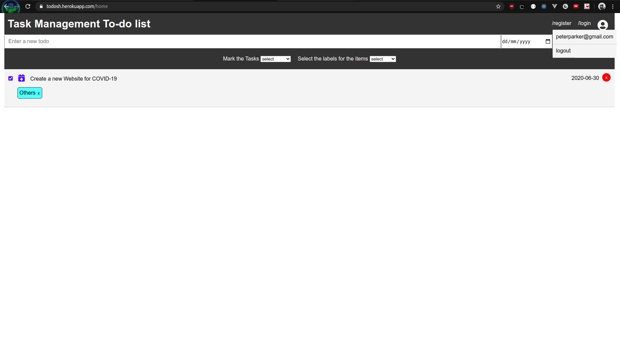
Todo App Logout option

Slide 12
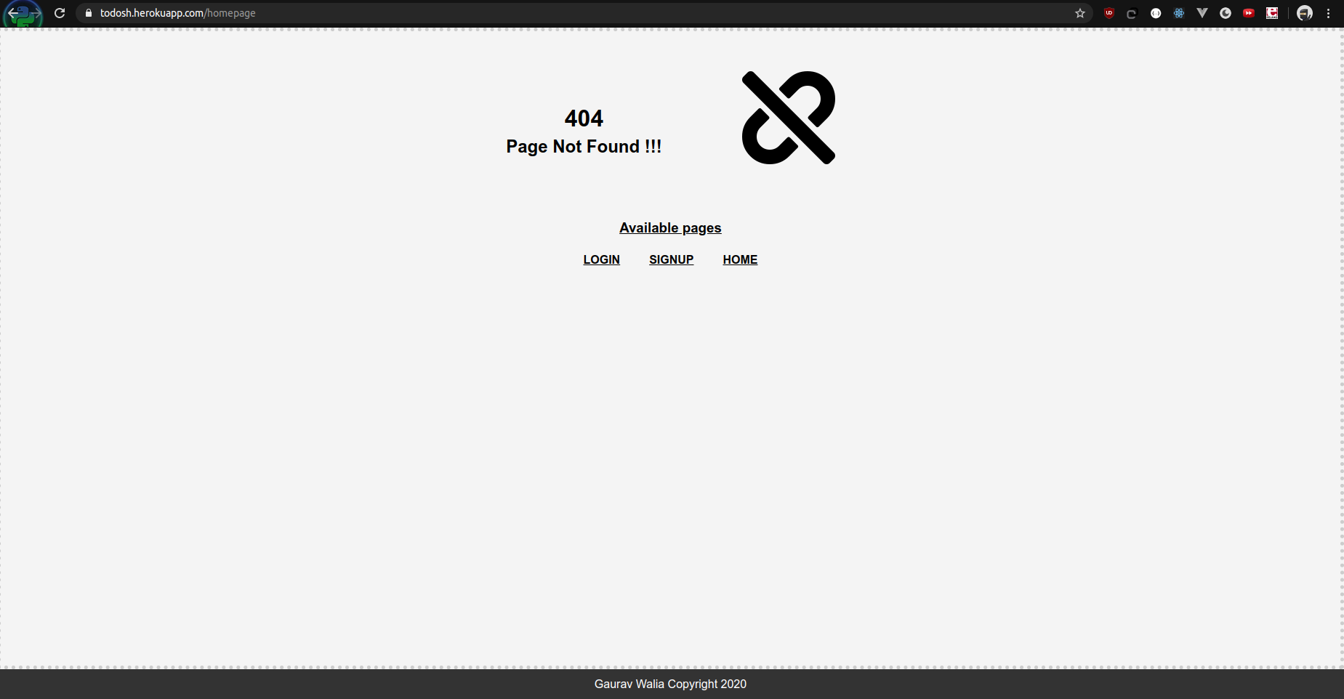
404 Page for wrong routes

Slide 13
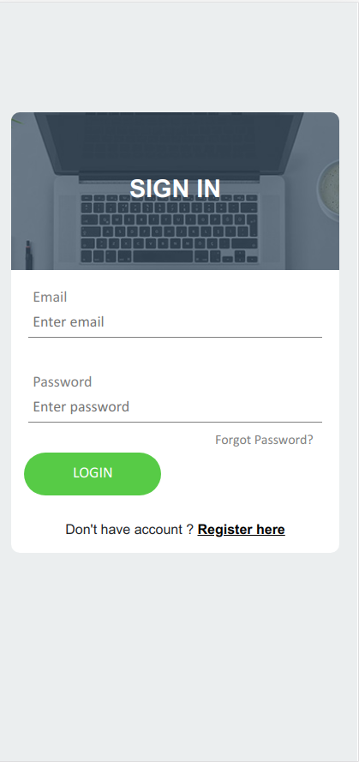
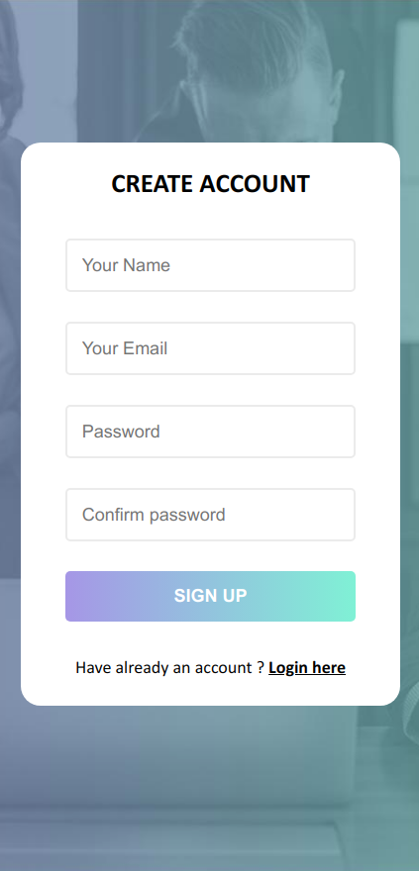
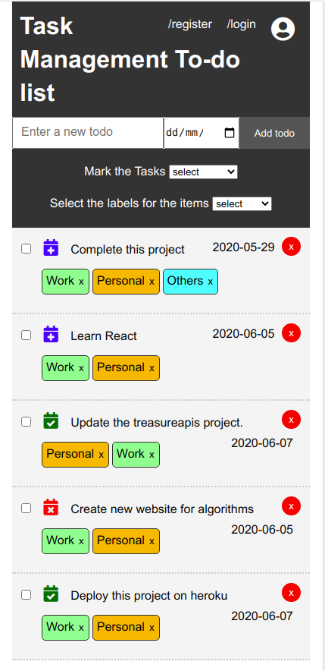
Mobile Screens

Slide 14
THANKS

